Slide 1
QUIZ GAME
Guide:
K. Shiva Ram Krishna
(Ass.Professor)
IT Department
Presented By:
CH.PRAJWAL-20891A1211
G.RAHUL-20891A1216
M.BHARATH VAMSI-20891A1229
K.MADHU MOHAN-20891A1222

Slide 2
ABSTRACT:
It consists of simple MCQ based on sports, general knowledge, technical content etc. Player just have to select the correct answers and can reach the next level .It is a very simple project with error-face sources.
This program in C focuses on creating interactive quizes possibly with a large data base of questions from various subjects.
This program utilized most of the important concepts in C and in applet design, the final output is displayed to be a user-friendly interactive quiz with which the user can gain the significant knowledge and get entertainment with value addition.

Slide 3
INTRODUCTION
A quiz is a form of game or mind sport in which the players(as individuals or in terms) attempt to answer questions correctly.
In some countries , a quiz is also a brief assessment used in education and similar field to measure growth in knowledge , abilities , and/or skills.
This ‘QUIZ GAME’ project is designed for a question in which you can generate and manage a simple database for questions.
The question number is automatically generated by the software and is stored in a binary file by the name ‘QUESTION’.

Slide 4
BLOCK DIAGRAM/CIRCUIT DIAGRAM:
Start
Main Menu
User Input
Start or Quit
Quit Game
Display Score
Stop

Slide 5
Software ReQUIREMENTS:
Windows 10 or higher
C- Compiler, CODE BLOCKS
HARDWARE REQUIREMENTS:
I3 processor or based computer or higher
Memory-1GB RAM
Hard Drive-50GB
Internet Connection
Android Device

Slide 6
PROBLEM STATEMENT
Youngsters in today society are going through a variety of phases in their mental health, and many are using social media to hand stress.
They use it mostly for academics , entertainment and informative purpose.
This prediction system focuses on creating a wide database of personality IQ and carrer -related questions.
It is designed to be user-friendly interactive predictor tests that would provide relevant information to the user.

Slide 7
MAIN MENU
Program display menu to the user to start the game or to quit.
User Input: The application steps to get
User Input: Decision tree if user input is 1 then quiz game start else if user input 2 then it display the correct answer.
1. If user input is 3 then it display the result.
2. If user input is 4 then the program will quit.
3. Quiz game use gets 5 questions one by one and correct answer score is marked as 1.

Slide 8
THE FUNCTIONALITY OF THE IQ PREDICTION TEST:
The IQ predictor test of our program provides questions of basic knowledge to the user and gives the score after evaluation.
The function in C is used to display the questions and the options and the correct answer is given to the compiler before hand to evaluate.
The user can check his/her score at the end of the test and also can choose the correct response to each question.
This quiz is same for all age groups and the result will differ from person to person.

Slide 9
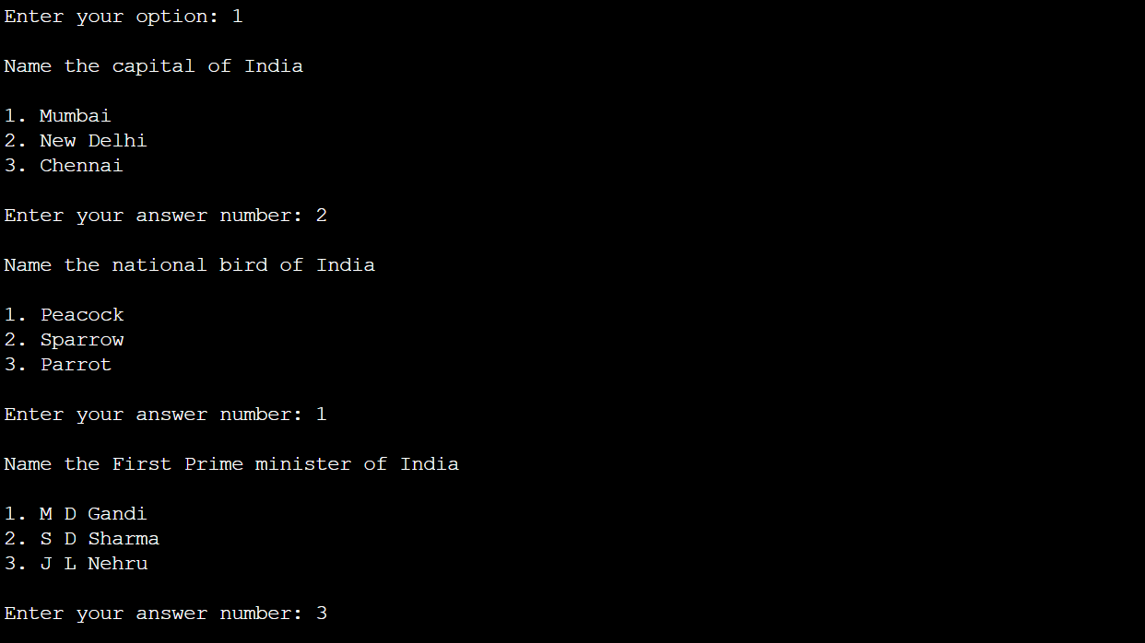
OUTPUT

Slide 10
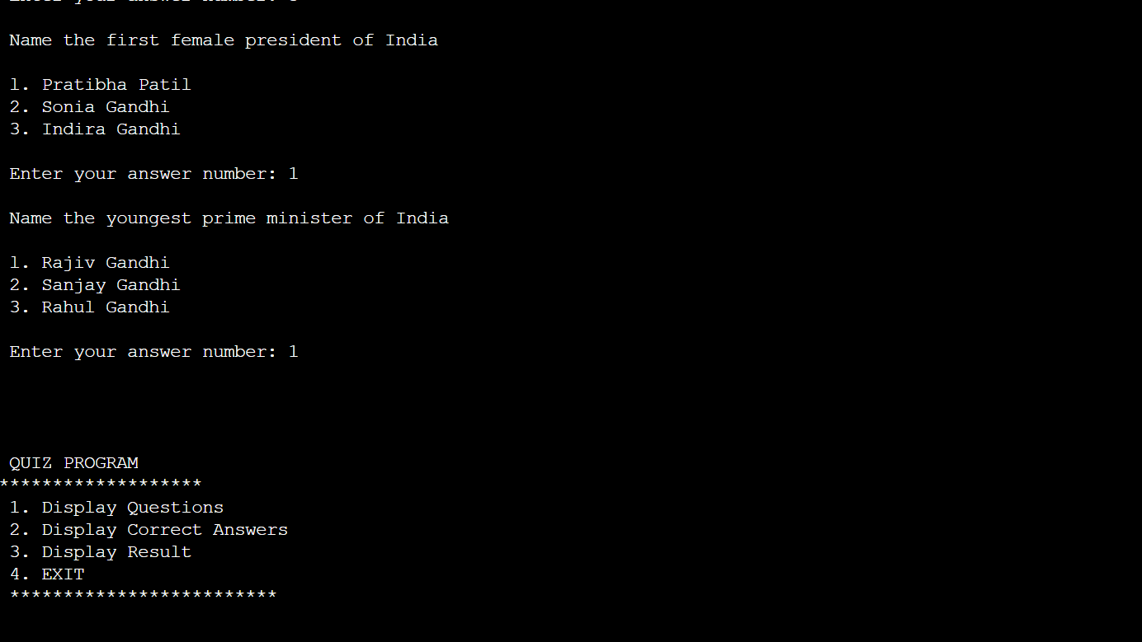

Slide 11
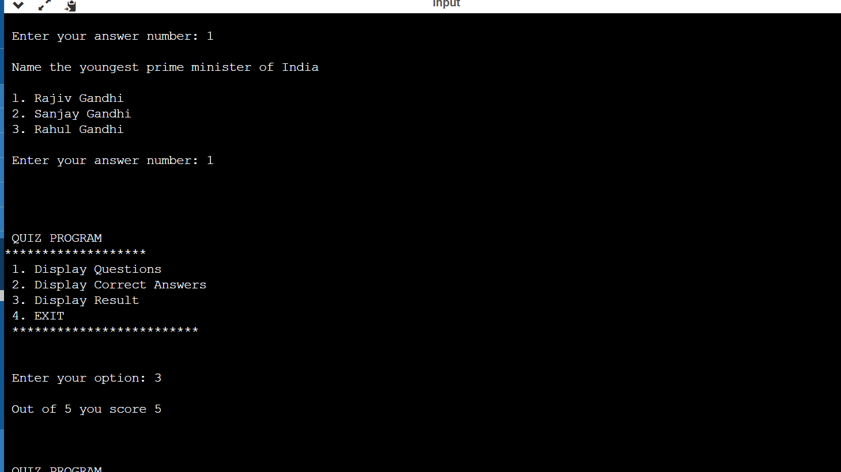

Slide 12
ADVANTAGES
Students feels interesting to answer and comes forward to know their knowledge.
Students feel more confident and clarify their doubts.
Students try to know the things practically.
Students try to know their grades by answering the questions.

Slide 13
CONCLUSION
After the user completes a quest i.e.. Personality prediction IQ carrer prediction the user is redirected to the main menu where he/she can retake any quist or exit the program by entering the user option.
The code is just for testing purposes only.
Each test is for entertainment only and is no way validation.
The concepts presented are not rooted in any Research. The code is edited in CODE BLOCKS and can be run in any C compiler.

Slide 14
THANK YOU

